Slide 1
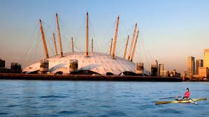
Young Voices 2025
WELCOME EVERYONE!

Slide 2
Young Voices 2025
Tuesday 4th February 2025
42 LHJS children
3 teachers
3 parent chaperones
14 additional adult coach travellers
31 evening concert tickets for families
Plus A LOT of excited Young Voices!

Slide 3
Staffing, Travel and Approx. Times
Normal start to school day in class
11.00am Hall: Early lunch *
11.30 depart school
1.20pm Arrival ‘Top-up’ Snack *
2.00pm Rehearsal
5pm Break / Packed Tea *
6pm Children in seats
7pm Concert starts
9pm Concert Finish
11.15pm Return to Linton (social media updates
* See next slide
Mrs Emma Mason
Mr Jamie Wilson
Mr Gracie
Philippa (Carys’ mum)
Sriyangi (Sethmi’s mum)
Jasvinder (Akira’s mum)
Parent chaperones / Coach adult travellers – please be at school by 11.25am

Slide 4
What do I need to know and bring?
Arrive on Tuesday 4th February for a normal start to the day.
Wear normal school uniform including jumper (clean trainers are fine).
Drop off any travel sickness medication / Forms to school office.
COACH BAG: - this will stay on the coach and not come into the O2
White T-shirt / YV T-shirt (we will change before we leave)
Packed lunch (this will be eaten in school before we leave)
Normal school reading book etc needed for class use
Warm layer (fleece?)
Extra snacks – including something as a top up after our early lunch!
OPTIONAL: game, book or notepad for the coach journey & small pillow / rug for return
CARRIER BAG: children carry this with them into O2.
Extra Top-up snack, following our early lunch ‘LABEL IT’!
Packed Tea & Drink / juice carton (no cans or glass)
Refillable Water Bottle

Slide 5
What do I need to know and bring?
Arrive on Tuesday 4th February for a normal start to the day.
Wear normal school uniform including jumper (clean trainers are fine).
Drop off any travel sickness medication / Forms to school office.
COACH BAG: - this will stay on the coach and not come into the O2
White T-shirt / YV T-shirt (we will change before we leave)
Packed lunch (this will be eaten in school before we leave)
Normal school reading book etc needed for class use
Warm layer (fleece?)
Extra snacks
OPTIONAL: game, book or notepad for the coach journey & small pillow / rug for return
CARRIER BAG: children carry this with them into O2.
Extra Top-up snack, following our early lunch ‘LABEL IT’
Packed Tea & Drink / juice carton (no cans or glass)
Refillable Water Bottle
If circumstances allow, children can arrive late (up to 10.40am) in school on Wednesday 5th Feb

Slide 6
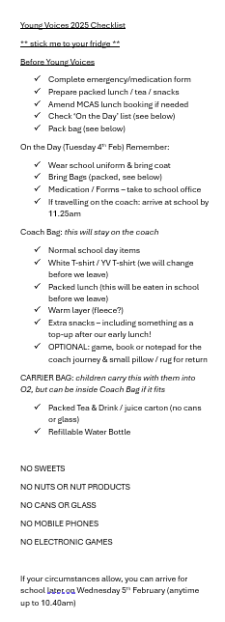
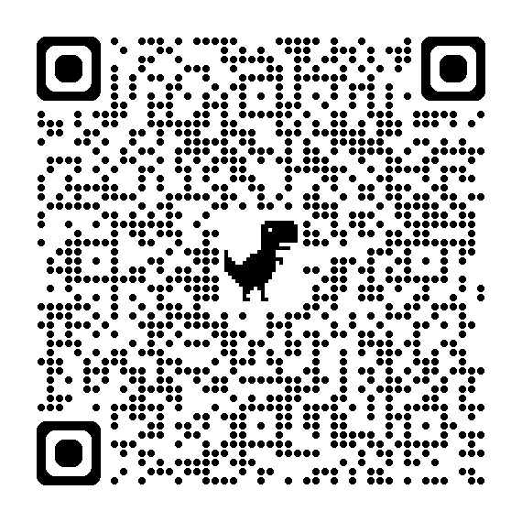
What do I need remember?
Please remember we are a nut free school
Please cancel any booked school lunch as you will be charged by INNOVATE
FSM / school can provide packed lunch if booked in the usual way
PARENTS PLEASE FILL OUT MEDICAL / EMERGENCY FORM BY MONDAY 27th JANUARY
https://forms.office.com/e/W1ETFHPSW5
Take a ‘Checklist’ to stick to your fridge!

Slide 7
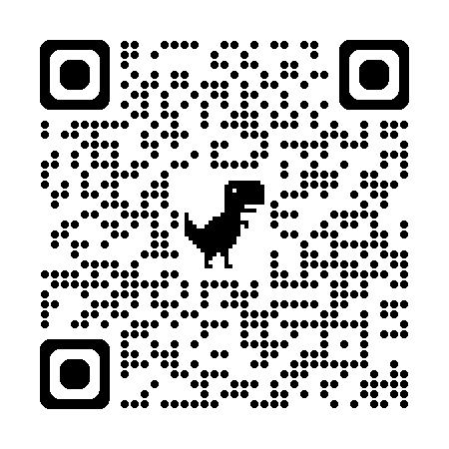
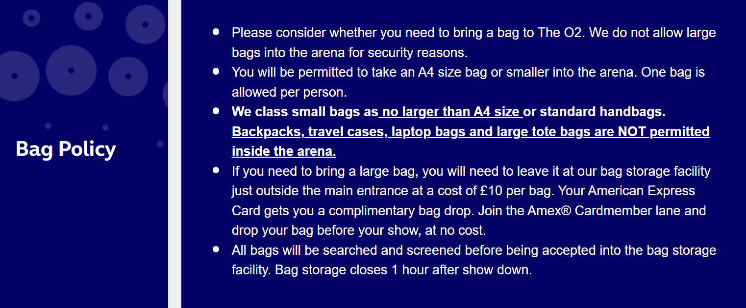
Evening Concert – are you attending?
Download AXS app
Check the O2 website - FAQs
https://help.theo2.co.uk/hc/en-gb
Plan ahead for parking / travel
Read O2 SECURITY & Bag Policy
https://www.theo2.co.uk/visit-us/security
Ensure AXS account is on a device with you at O2, and uses the email that Mrs Mason has for choir.
If you are travelling with us on the coach, please remember to take the coach driver’s details (registration no. / telephone no.) and follow instructions for being back at the coach on time.
In the unlikely event of an emergency evacuation of 02, please follow instructions from arena security.
We will do the same, prioritising the children’s safety. We will depart on our coach. We will contact you when it is safe to so.

Slide 8
Journey to Young Voices

Slide 9
Journey to Young Voices
M11
A12
Blackwall Tunnel
(River Thames)
Greenwich – London
Approx 1 hr 50

Slide 10
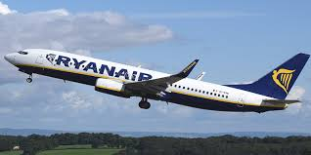
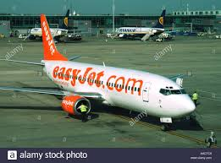
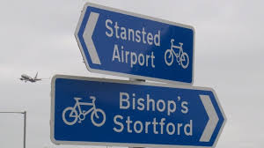
Journey to Young Voices
M11
A12
Blackwall Tunnel
(River Thames)
Greenwich – London
Approx 1 hr

Slide 11
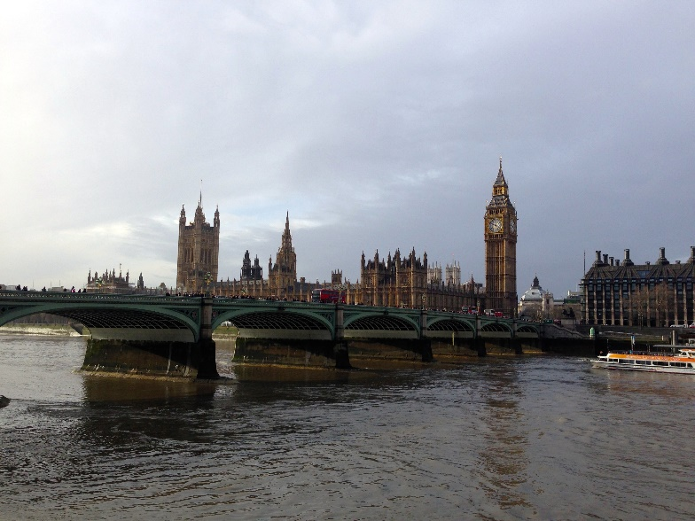
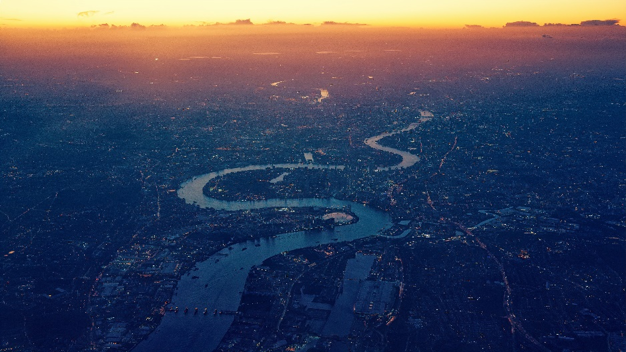
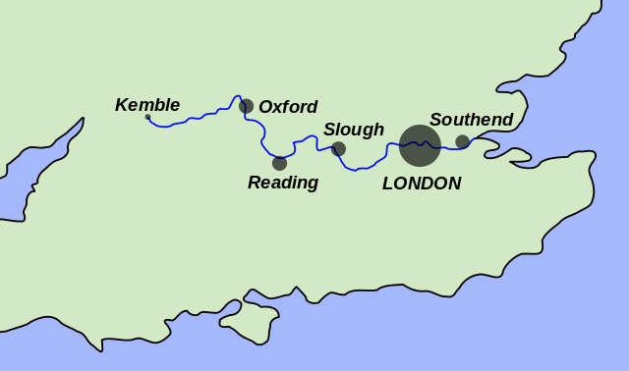
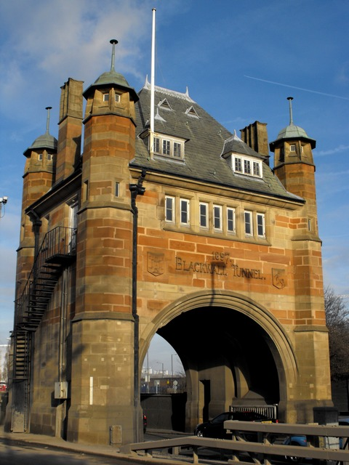
Journey to Young Voices
River Thames
LINTON

Slide 12
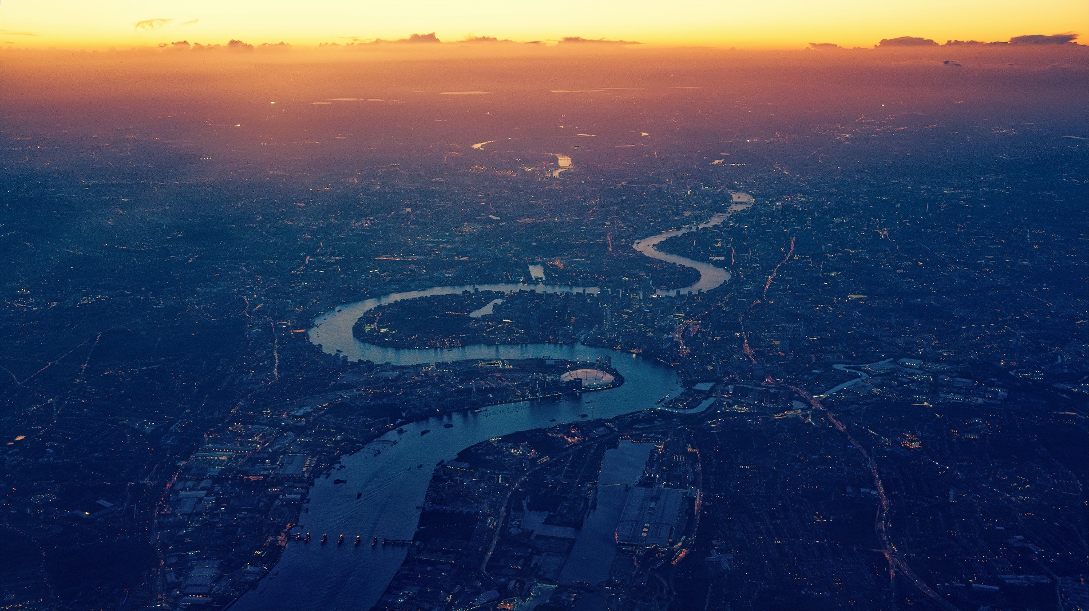
Journey to Young Voices
M11
A12
Blackwall Tunnel
(River Thames)
Greenwich – London
Approx 1 hr 50

Slide 13
Journey to Young Voices
M11
A12
Blackwall Tunnel
(River Thames)
Greenwich – London
Approx 1 hr 50

Slide 14
Journey to Young Voices
M11
A12
Blackwall Tunnel
(River Thames)
Greenwich – London
Approx 1 hr 50

Slide 15
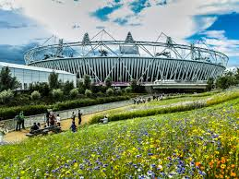
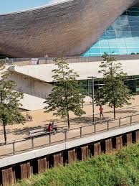
Journey to Young Voices
orbit
M11
A12
Blackwall Tunnel
(River Thames)
Greenwich – London
Approx 1 hr 50
Queen Elizabeth Park

Slide 16
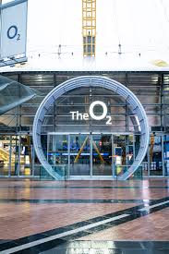
Journey to Young Voices
M11
A12
Blackwall Tunnel
(River Thames)
Greenwich – London
Approx 1 hr 50

Slide 17
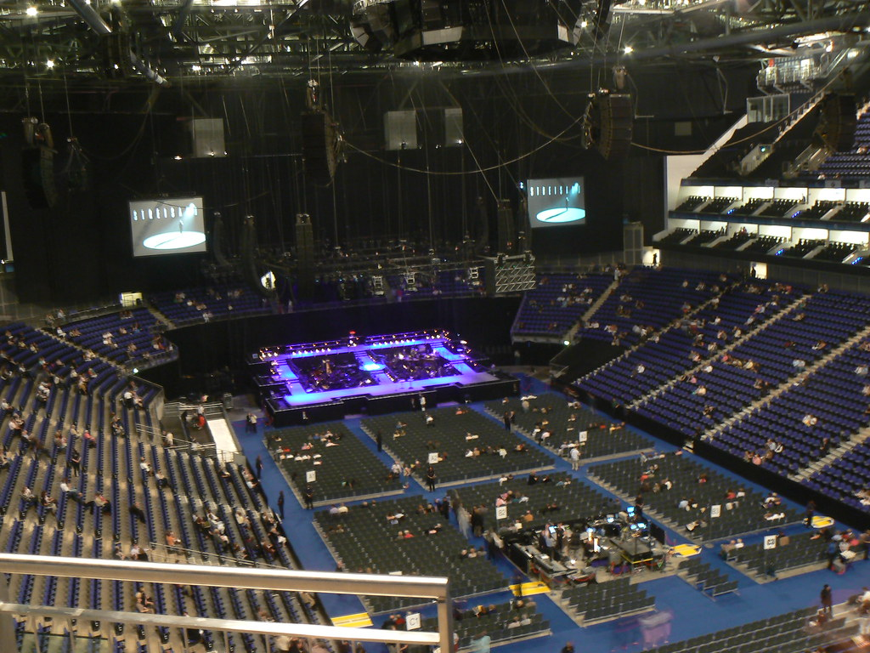
Journey to Young Voices
M11
A12
Blackwall Tunnel
(River Thames)
Greenwich – London
Approx 1 hr 50
Young Voices 2024: PHOTOS

Slide 18
Journey to Young Voices
M11
A12
Blackwall Tunnel
(River Thames)
Greenwich – London
Approx 1 hr 50

Slide 19
Staffing, Travel and Approx. Times
Normal start to school day in class
11.00am Hall: Early lunch
11.30 depart school
1.20pm Arrival ‘Top-up’ Snack
2.15pm Rehearsal
5pm Break / Packed Tea
6pm Children in seats
7pm Concert starts
9pm Concert Finish
11.15pm Return to Linton (social media updates
Mrs Emma Mason
Mr Jamie Wilson
Mr Gracie
Philippa (Carys’ mum)
Sriyangi (Sethmi’s mum)
Jasvinder (Akira’s mum)
Parent chaperones / Coach adult travellers – please be at school by 11.25am

Slide 20
What do I need to know and bring?
Arrive on Tuesday 4th February for a normal start to the day.
Wear normal school uniform including jumper (clean trainers are fine).
Drop off any travel sickness medication / Forms to school office.
COACH BAG: - this will stay on the coach and not come into the O2
White T-shirt / YV T-shirt (we will change before we leave)
Packed lunch (this will be eaten in school before we leave)
Normal school reading book etc needed for class use
Warm layer (fleece?)
Extra snacks – including something as a top up after our early lunch!
OPTIONAL: game, book or notepad for the coach journey & small pillow / rug for return
CARRIER BAG: children carry this with them into O2.
Packed Tea & Drink / juice carton (no cans or glass)
Refillable Water Bottle
If circumstances allow, you can arrive late (up to 10.40am) in school on Wednesday 5th Feb

Slide 21
Any Questions?

