Slide 1
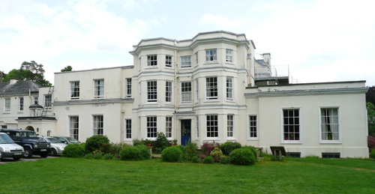
Woodrow High House Residential
Wednesday 3rd June – Friday 5th July
While we are waiting for everyone, please make sure you have signed in, taken a Med A form (medical permission slip) and kit list.

Slide 2
Adults
Mrs Chapman
Mr Gracie
Miss Rootes
Mrs Rootes
Mr Gyford

Slide 3
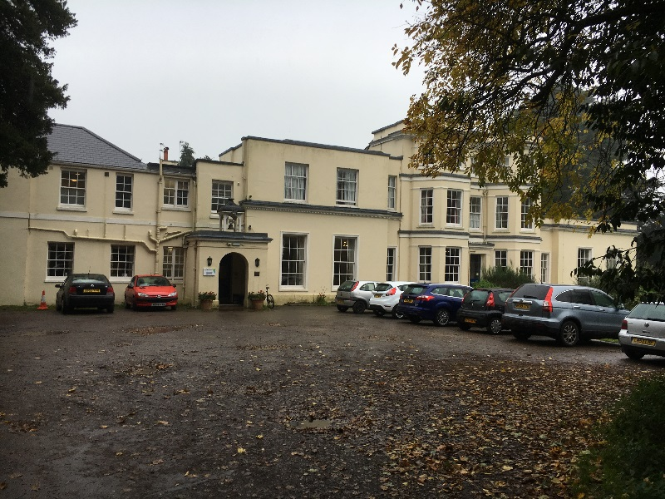
Woodrow High House site
Woodrow High House is a 17th century manor house set in 24 acres of safe and secure grounds in Buckinghamshire
Fully catered (3 hot meals a day!)
All activities are all onsite

Slide 4
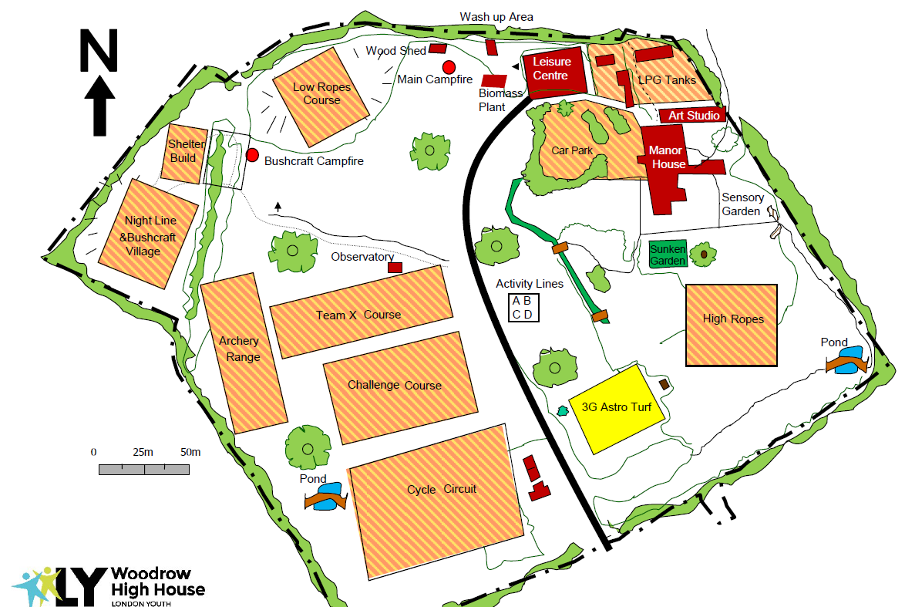
Map of the site

Slide 5
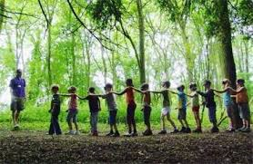
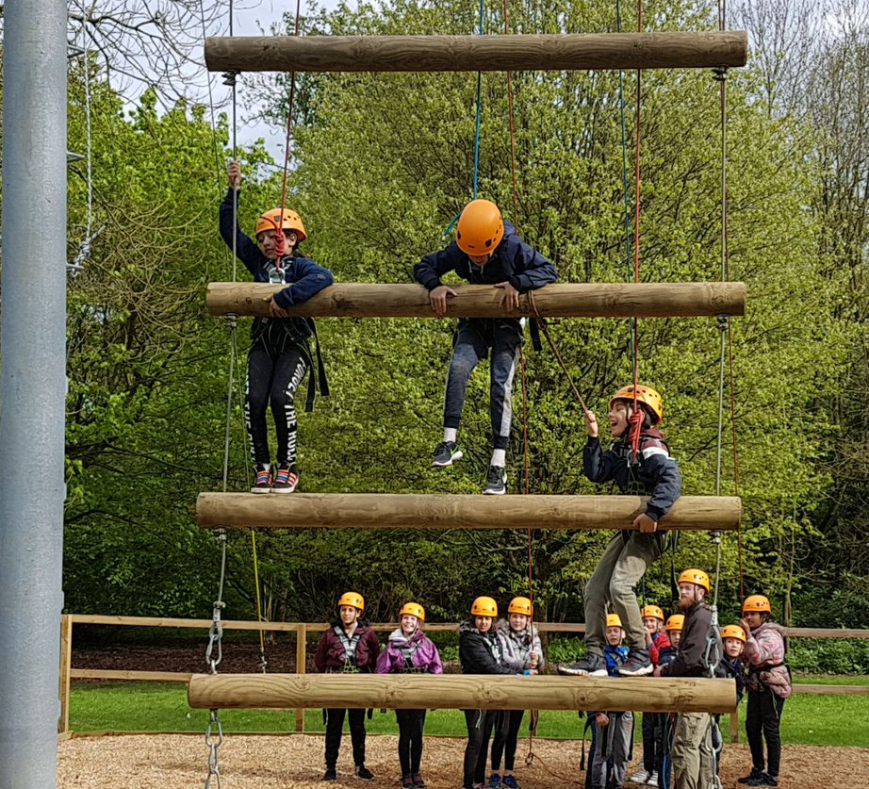
A typical day
7:45 AM BREAKFAST
9:15 AM ACTIVITY 1
11:00 AM ACTIVITY 2
12.30 PM LUNCH
2.00 PM ACTIVITY 3
3:45 PM ACTIVITY 4
5.30 PM EVENING MEAL
7.30 PM EVENING ACTIVITY
9.30PM BED

Slide 6
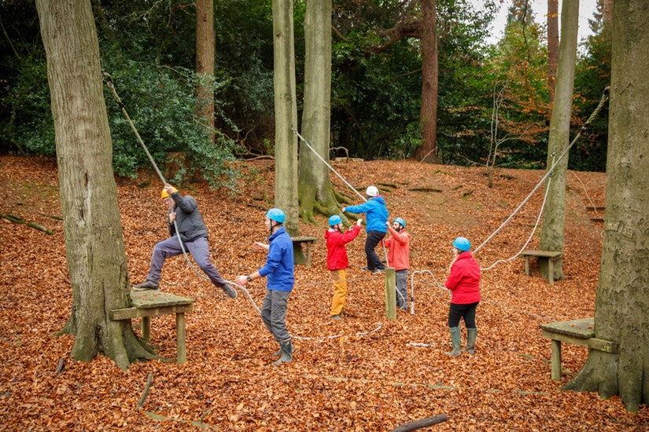
Activities
High Ropes Traverse
High Ropes Crate Stack
Bushcraft
Nightline
Drop it, Pop it
Archery
Challenge Course
Evening activities:
Campfire / Outdoor Games

Slide 7
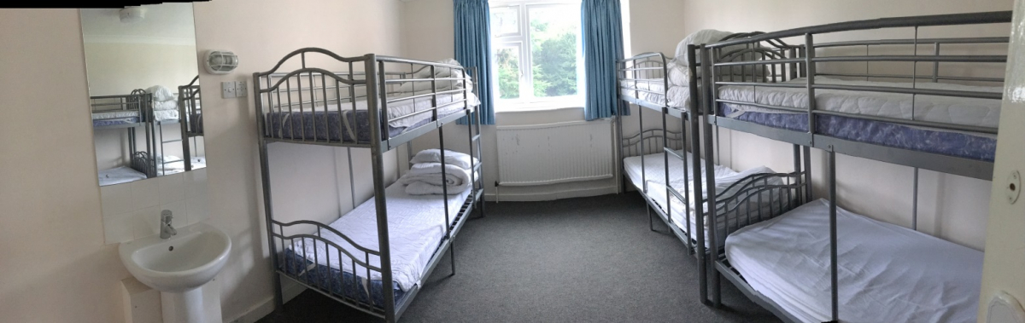
Dormitories
The children sleep in bunk beds and the number in each room varies according to the size of the room. The minimum number of children per room is 4 and the maximum is 10.
Children will be with their friends as far as possible.
The teachers’ bedrooms are interspersed amongst the children’s rooms (we are all on the same floor).
They provide all the bed linen but the children are asked to make their own beds.
Bathroom facilities are easily accessible from the bedrooms.

Slide 8
Food
From their website:
Our aim for young people who visit our centre is to be as active and healthy as possible; we therefore take care in choosing the menu options at Woodrow.
We provide three hot meals per day.
To help assist young people in selecting a balanced meal, fruit and salad are available with both lunch and dinner.
Water and squash
are always available.
The catering company
has a contract for lots
of school catering.

Slide 9
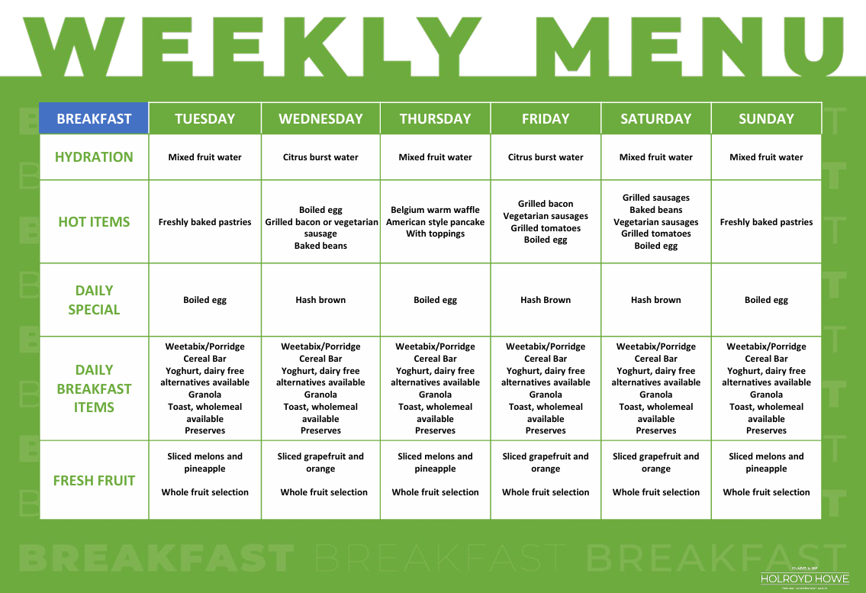
Sample Breakfast Menu

Slide 10
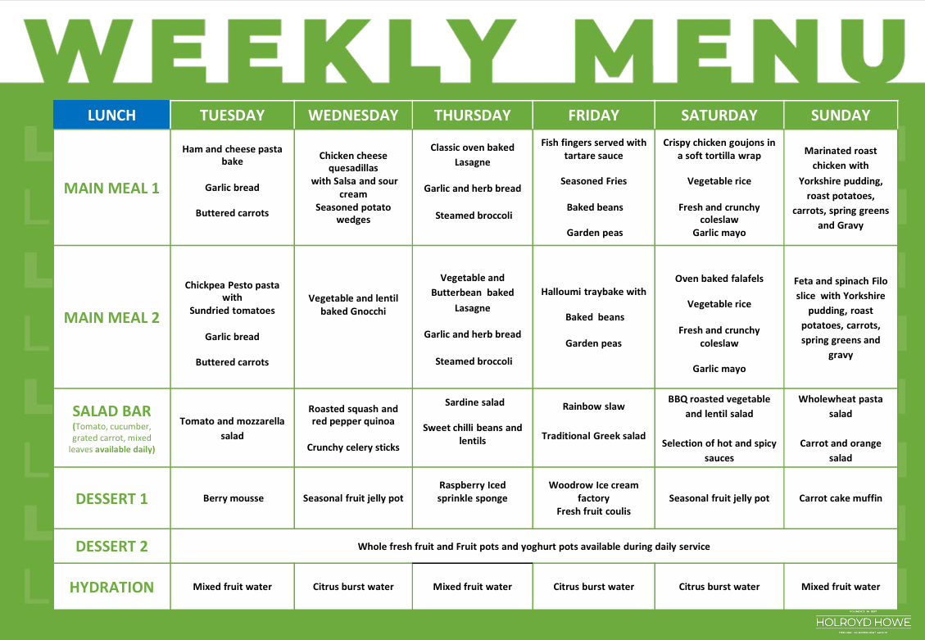
Sample Lunch Menu

Slide 11
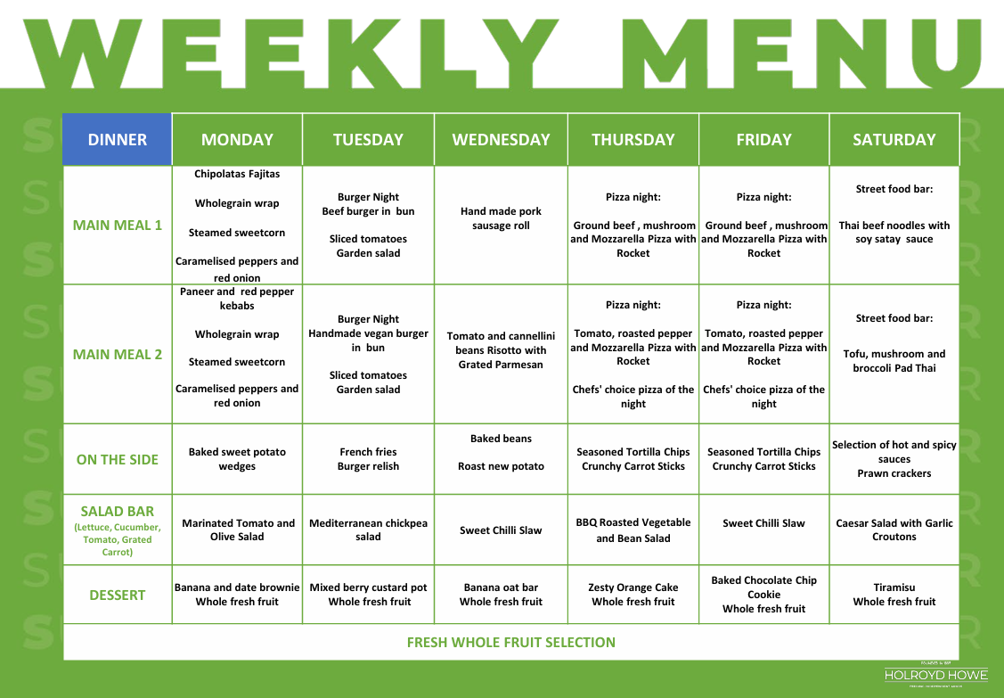
Sample Dinner Menu

Slide 12
What to bring
Kit list : essentially comfortable clothing for every day and every weather!
A packed lunch for Wednesday – in a disposable container i.e. not a lunchbox.
A refillable water bottle with sports cap.
One towel
A rucksack – containing packed lunch, water bottle, coat and whatever else you might need on the first day.
Money – no more than £5 (coins if possible). Children will be allowed to spend some on sweets/chocolate/crisps etc and some on souvenirs.
Bin bag for washing!
NAME EVERYTHING!

Slide 13
What NOT to bring
No aerosols – fire hazard
No electronics (disposable cameras are allowed but not essential)
No phones
Anything precious that you would be devastated to lose.
No food (food will be given back at the end of the trip if confiscated)

Slide 14
Departure and Return
Leave school at 09:00 so arrive at school at 08:30 on Wednesday.
Return to school at 16:00 on Friday
(although M25 on a Friday afternoon might be fun!)

Slide 15
Additional information
First aid trained
We will contact school when we arrive and share a Canva link with pictures
Behaviour
Medical form (MED A) and medicine to be bought into school as soon as possible.

Slide 16
Questions asked during the meeting:
Are there going to be other children there? Yes – but we won’t be sharing any of the activities
Will any other schools have access to our area or rooms? No – only our staff
Are there showers in the rooms? No – there are showers down each corridor for children to share
Can children bring sweets/snacks on the coach? Yes
How will you arrange who is in each room and group? Children will give us suggestions and we will ensure that they are either in the same room or group.
Is there a preference in what type of case children need? A bag that they can carry and fit under a bed.
What footwear do we need? Shoes for outside, that you do not mind getting dirty, and indoor shoes or slippers.
Do we need bedding/duvet? No, this is provided.
What type of food is available for each meal? There will be a range of food for the children to choose from.
Will Woodrow be made aware of any allergies? Yes – we will give them this information prior to our visit
Can we take books to read? Yes
Do children keep there money on them? Yes – If you would rather an adult looked after it, put it in an envelope with their name and give to Mrs Ball
Are children allowed to take any additional food? No – only their lunch for Wednesday and snacks for the coach.

